Slide 1


Building an Algorithmic Equity Selection System
This presentation outlines a robust, multi-phase approach to constructing an algorithmic equity-selection system. Our goal is to leverage fundamental analysis with advanced AI and real-time sentiment to identify high-potential equities in the Nifty 500 universe.

Slide 2

Phase 1: The Foundation - Rules-Based Filtering
PHASE 1
FOUNDATION
1
2
Data Ingestion
Filtering Integration
Automate the collection of the Nifty 500 universe and their last five years of financial statements, ensuring data integrity from official sources or Python libraries.
Implement hard-coded logic to filter for quality. This acts as a gatekeeper, eliminating undesirable companies from the investment universe.
3
Quality Universe Output
The filtering process significantly narrows the selection, yielding a 'Quality Universe' of approximately 50-60 high-quality stocks for further analysis.

Slide 3



Phase 1: Non AI
Our initial filter employs strict financial metrics to ensure we are only considering fundamentally sound companies. These criteria are designed to identify financially healthy and stable businesses.
Return on Equity (ROE) > 15%
Debt-to-Equity < 1.0
Positive Operating Cash Flow
Indicates prudent financial management and lower leverage risk.
Ensures superior profitability and efficient capital utilisation.
Confirms the company generates sufficient cash from its core operations.
These criteria are crucial for eliminating 'noise' and mitigating the risks associated with speculative or financially distressed entities, forming a solid foundation for subsequent phases.

Slide 4
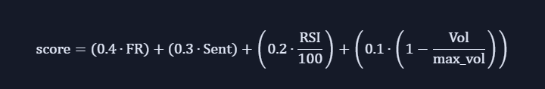
Phase 2: The Intelligence - AI & Live Sentiment
PHASE 2
INTELLIGENCE
This phase integrates artificial intelligence and real-time data to predict price action based on both quantitative metrics and dynamic market events.
Real-Time Data Pipelines
Establish live data streams via Websocket for price ticks and corporate announcements, and REST APIs for news sentiment.
Technical indicators
1
2
3
3
Sentiment Scoring Module
Final score
Utilise an NLP model, such as FinBERT, to process news headlines and assign a sentiment score from -1 (Negative) to +1 (Positive).
Based on the data of phase 2 and the fundamental ranking
.

Slide 5

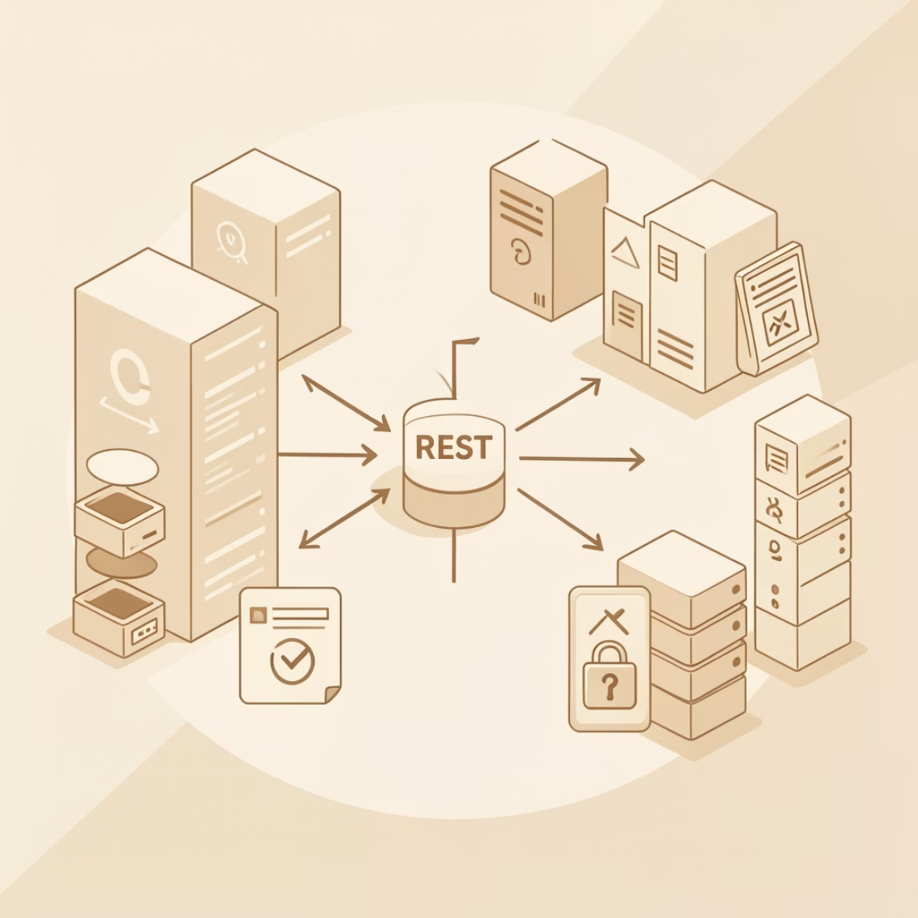
Real-Time Data Pipelines: Capturing Market Pulse
Websocket Connection
REST API (Sentiment)
A direct, persistent connection for instantaneous data flow. This allows us to capture:
A robust interface for pulling structured news data, focusing on:
News headlines from key Indian financial media (e.g., Economic Times, MoneyControl).
Real-time price ticks for immediate volatility detection.
Live corporate announcements (mergers, earnings) impacting stock movements.
Gathering critical information for sentiment analysis without delay.
These pipelines are critical for feeding our AI with timely information, ensuring our predictions are based on the freshest market intelligence.

Slide 6



The Master Algorithm: Final Ranking Formula
This core equation precisely blends the long-term financial health of companies with dynamic, real-time market intelligence to generate our definitive stock ranking.
By assigning a higher weight to the AI-driven score, we ensure our selections are agile and responsive to immediate market shifts, while still grounded in fundamental strength derived from our robust initial filtering.
Fundamental Rank
Weight: 0.4
Final Ranking Formula
Final Ranking Score
AI Sentiment/Price Score
Combined weighted result
Weight: 0.6

Slide 7
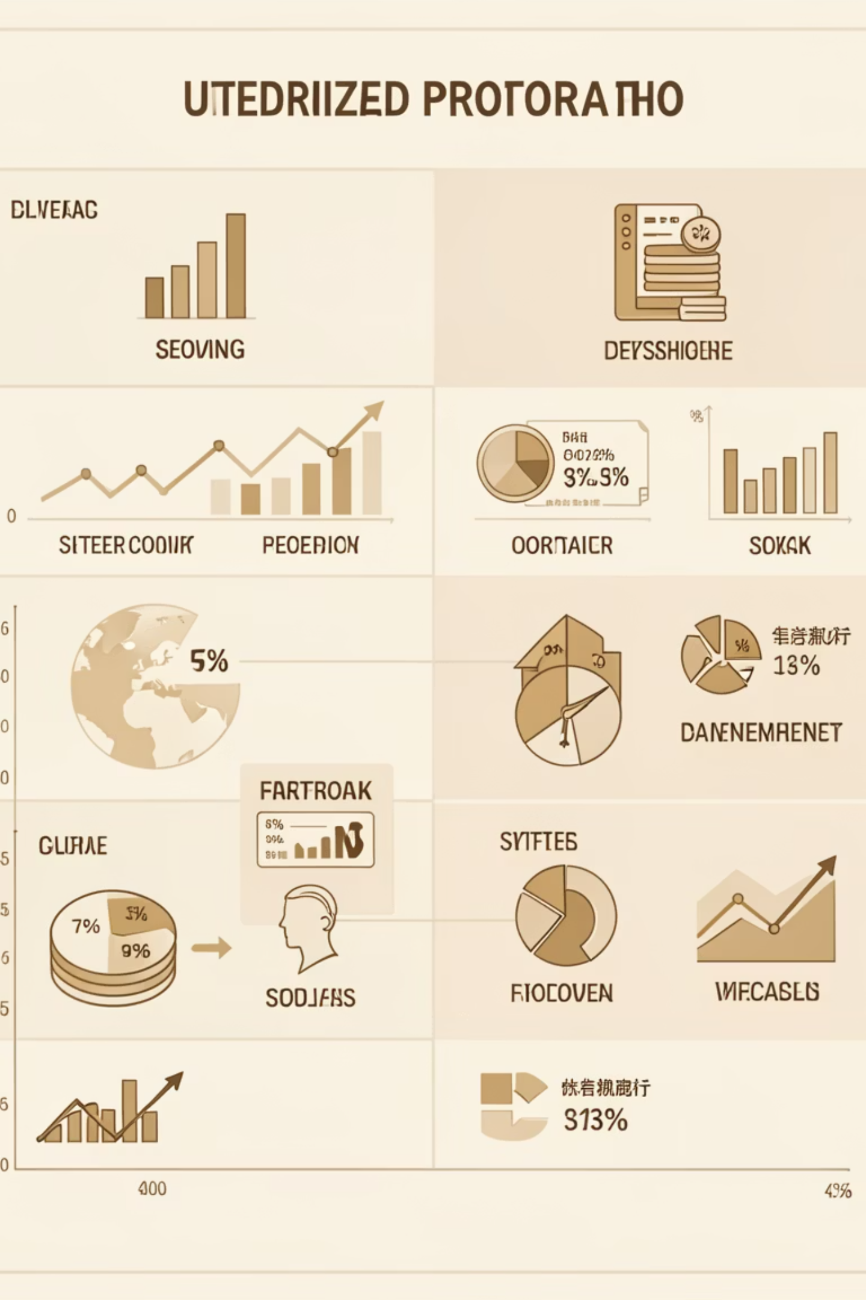
Portfolio Construction: Optimised Selection
Top 10 Stock Selection
1
The system autonomously selects the ten highest-ranked stocks based on the Master Algorithm's final scores.

Slide 8
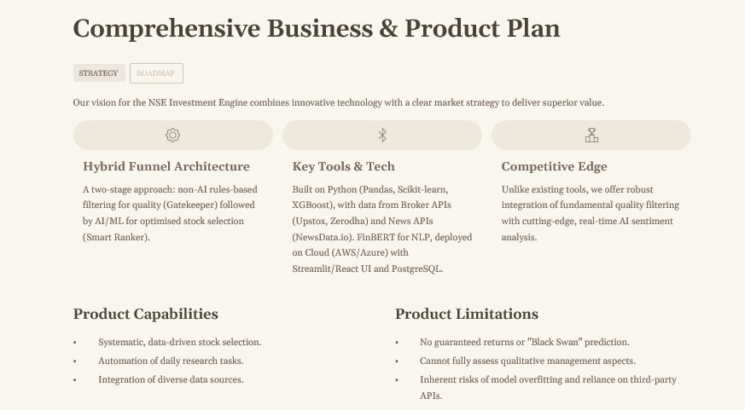

Slide 9
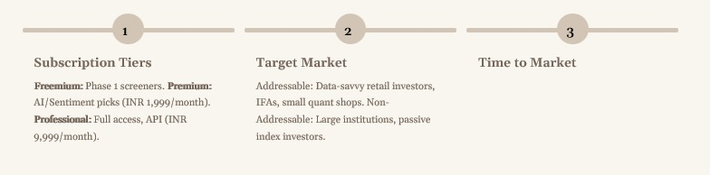
Monthly Performance Review
The estimated time to market is ~6 months for an MVP launch.
Month 1-3: Design and Phase 1 Development.
Month 4: Phase 2 AI/NLP Development.
Month 5-6: Integration and Testing.
A phased approach is proposed:
MVP Launch (Month 6): Basic screener for early revenue.
Phase 2 (Month 9): Release AI scores as a premium feature.
Phase 3 (Month 12): Add real-time sentiment and automation features.

